Slide 1
CNN for the ASL Alphabet
A Python Keras model for detecting the ASL Alphabet in images
Machine learning Final Project, Michael Booton, University of Dallas
Python 3.7, Tensor flow 2.2

Slide 2


End Goal
Text Editor using ASL as input
Train ASL CNN
Train a new sequential ASL CNN that recognize signs done in motion using first CNN
Use new ASL CNN for input to text editor,
Allow backspace, special characters, etc

Slide 3
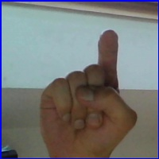
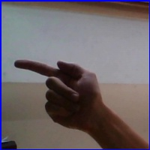
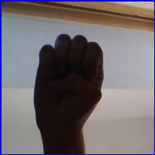
Data Set
X
3500 images per sign at varying levels of contrast, orientation, and position in the frame
Credit Kaggle user Paul Timothy Mooney
https://www.kaggle.com/paultimothymooney/interpret-sign-language-with-deep-learning/output
G
E

Slide 4
Pre-processing
Reduce to black and white
Convert to Tensor
Saved as Numpy Array

Slide 5
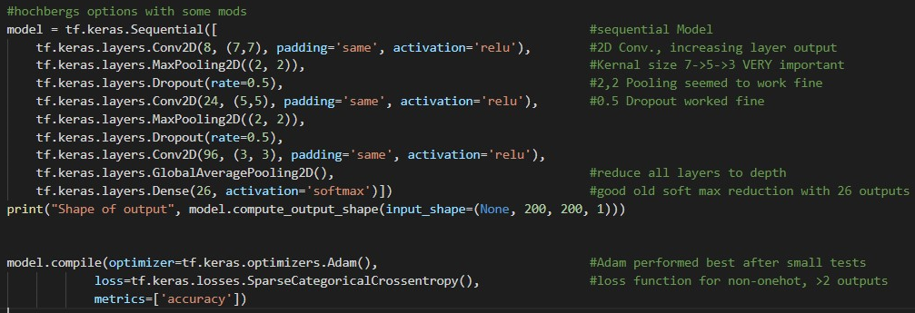
Topology

Slide 6
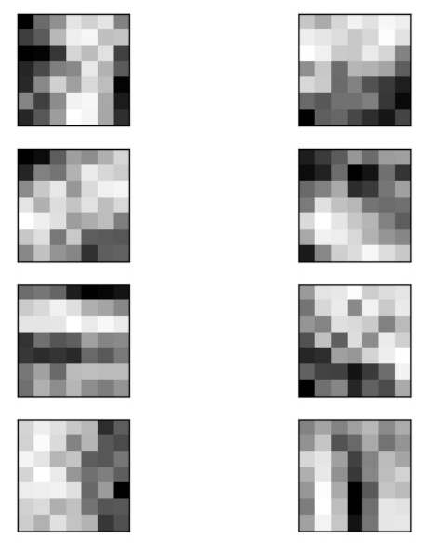

First Level Visualization
Code Courtesy of Dr. Hochberg’s Finger Model

Slide 7
Accuracies
A | 95.52% | G | 91.19% | N | 99.29% | T | 89.96%
B | 99.30% | H | 99.34% | O | 99.66% | U | 72.73%
C | 99.65% | I | 98.62% | P | 99.37% | V | 62.66%
D | 98.35% | J | 99.31% | Q | 100.00% | W | 98.99%
E | 98.90% | L | 99.00% | R | 96.41% | Y | 98.30%
F | 99.64% | M | 87.11% | S | 87.88%

Slide 8
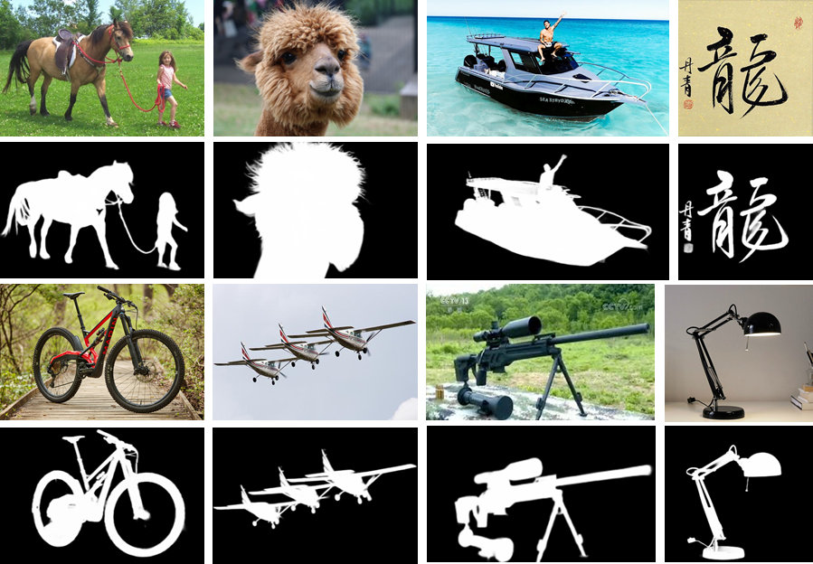
Next Steps
U^2-Net for Preprocessing
Going Deeper with Nested U-Structure for Salient Object Detection
Used Torchnet
Xuebin Qin, Zichen Zhang, Chenyang Huang, Masood Dehghan, Osmar R. Zaiane and Martin Jagersand.
https://github.com/NathanUA/U-2-Net

Slide 9
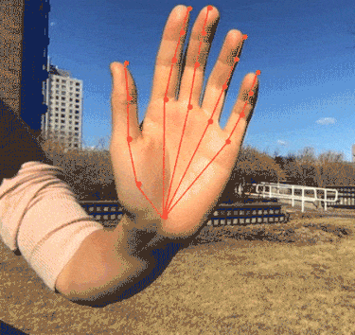
Accuracies
Next Steps
Use TF Hub Handpose model to use key points and bounding box
Ann Yuan and Andrey Vakunov, Software Engineers at Google
https://blog.tensorflow.org/2020/03/face-and-hand-tracking-in-browser-with-mediapipe-and-tensorflowjs.html
https://storage.googleapis.com/tfjs-models/demos/handpose/index.html

Slide 10
Create Engine and Editor
Use the new CNN to train a video input feed classifier
Build the Editor
Increment functionality!

